Slide 1
GRAPH THEORY
BY
DS

Slide 2
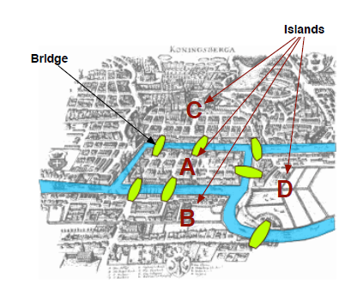
BACKGROUND
Graph Theory began with Leonhard Euler in his study of the Bridges of Konigsburg problem. Here's how it started: The city of Konigsburg exists as a collection of islands connected by bridges as shown in Figure

Slide 3
The problem Euler wanted to analyze was
Is it possible to go from island to island traversing each bridge only once? This was assuming that there was no trickery such as using a boat.
Euler analyzed the problem by simplifying the representation and as a result created modern graph theory

Slide 4
WHAT IS A GRAPH?
N DEO GRAPH_MARKED.pdf

Slide 5
THANK YOU

